Slide 1
REMOTE INVOCATION
GROUP MEMBERS
JONES OIRA NYAMWEYA
CLINTON COLLINS MAINYA
DERRICK MWAURA MAINA

Slide 2
Request-Reply Protocols
Communication Types
Asynchronous: sender continues sending of requests after submission
Synchronous: sender is blocked after sending of requests until;
– message is stored at receiver’s host
– message is received
– reply is received

Slide 3
Basically all client/server communication follows the pattern of a request/reply protocol:
– the client sends a request message
– the server executes the requested operation
– the server responds with a reply message

Slide 4
Remote Procedure Call (RPC)
A remote procedure call is an interprocess communication technique that is used for client-server based applications. It is also known as a subroutine call or a function call.
A client has a request message that the RPC translates and sends to the server. This request may be a procedure or a function call to a remote server.
When the server receives the request, it sends the required response back to the client. The client is blocked while the server is processing the call and only resumed execution after the server is finished.

Slide 5
The sequence of events in a remote procedure call are given as follows −
The client stub is called by the client.
The client stub makes a system call to send the message to the server and puts the parameters in the message.
The message is sent from the client to the server by the client’s operating system.
The message is passed to the server stub by the server operating system.
The parameters are removed from the message by the server stub.
Then, the server procedure is called by the server stub.

Slide 6
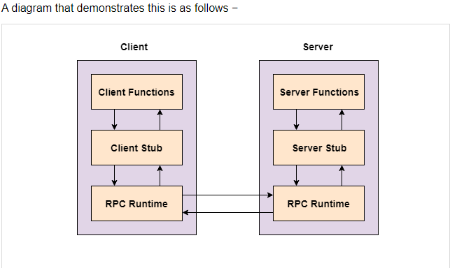

Slide 7
ADVANTAGES
Remote procedure calls support process oriented and thread oriented models.
The internal message passing mechanism of RPC is hidden from the user.
The effort to re-write and re-develop the code is minimum in remote procedure calls.
Remote procedure calls can be used in distributed environment as well as the local environment.
Many of the protocol layers are omitted by RPC to improve performance.

Slide 8
DISADVANTAGES
The remote procedure call is a concept that can be implemented in different ways. It is not a standard.
There is no flexibility in RPC for hardware architecture. It is only interaction based.
There is an increase in costs because of remote procedure call.

Slide 9
Remote Method Invocation
RMI stands for Remote Method Invocation. It is a mechanism that allows an object residing in one system (JVM) to access/invoke an object running on another JVM.
RMI is used to build distributed applications; it provides remote communication between Java programs. It is provided in the package java.rmi.

Slide 10
Architecture of an RMI Application
In an RMI application, we write two programs, a server program (resides on the server) and a client program (resides on the client).
Inside the server program, a remote object is created and reference of that object is made available for the client (using the registry).
The client program requests the remote objects on the server and tries to invoke its methods.
The following diagram shows the architecture of an RMI application.

Slide 11
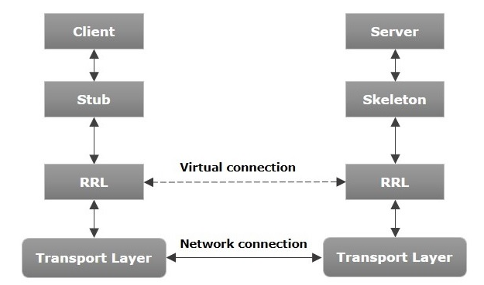
Architecture of the RMI

Slide 12
RMI Architecture
Transport Layer − This layer connects the client and the server. It manages the existing connection and also sets up new connections.
Stub − A stub is a representation (proxy) of the remote object at client. It resides in the client system; it acts as a gateway for the client program.
Skeleton − This is the object which resides on the server side. stub communicates with this skeleton to pass request to the remote object.
RRL(Remote Reference Layer) − It is the layer which manages the references made by the client to the remote object.

Slide 13
Working of an RMI Application
When the client makes a call to the remote object, it is received by the stub which eventually passes this request to the RRL.
When the client-side RRL receives the request, it invokes a method called invoke() of the object remoteRef. It passes the request to the RRL on the server side.
The RRL on the server side passes the request to the Skeleton (proxy on the server) which finally invokes the required object on the server.
The result is passed all the way back to the client.

Slide 14
Marshalling and Unmarshalling
Whenever a client invokes a method that accepts parameters on a remote object, the parameters are bundled into a message before being sent over the network.
These parameters may be of primitive type or objects. In case of primitive type, the parameters are put together and a header is attached to it. In case the parameters are objects, then they are serialized. This process is known as marshalling.
At the server side, the packed parameters are unbundled and then the required method is invoked. This process is known as unmarshalling.

Slide 15
RMI Registry
RMI registry is a namespace on which all server objects are placed. Each time the server creates an object, it registers this object with the RMIregistry (using bind() or reBind() methods).
These are registered using a unique name known as bind name.
To invoke a remote object, the client needs a reference of that object. At that time, the client fetches the object from the registry using its bind name (using lookup() method).

Slide 16
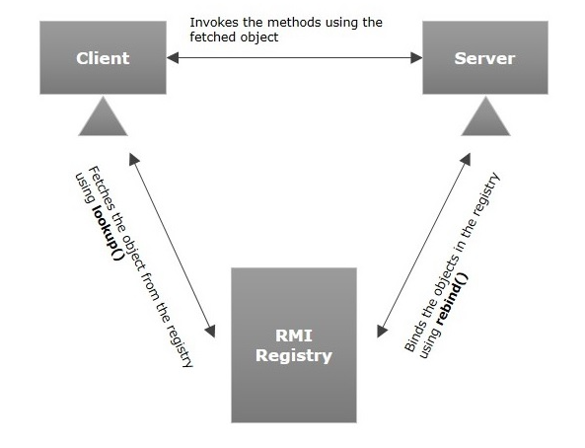

Slide 17
Goals of RMI
To minimize the complexity of the application.
To preserve type safety.
Distributed garbage collection.
Minimize the difference between working with local and remote objects.

